Slide 1
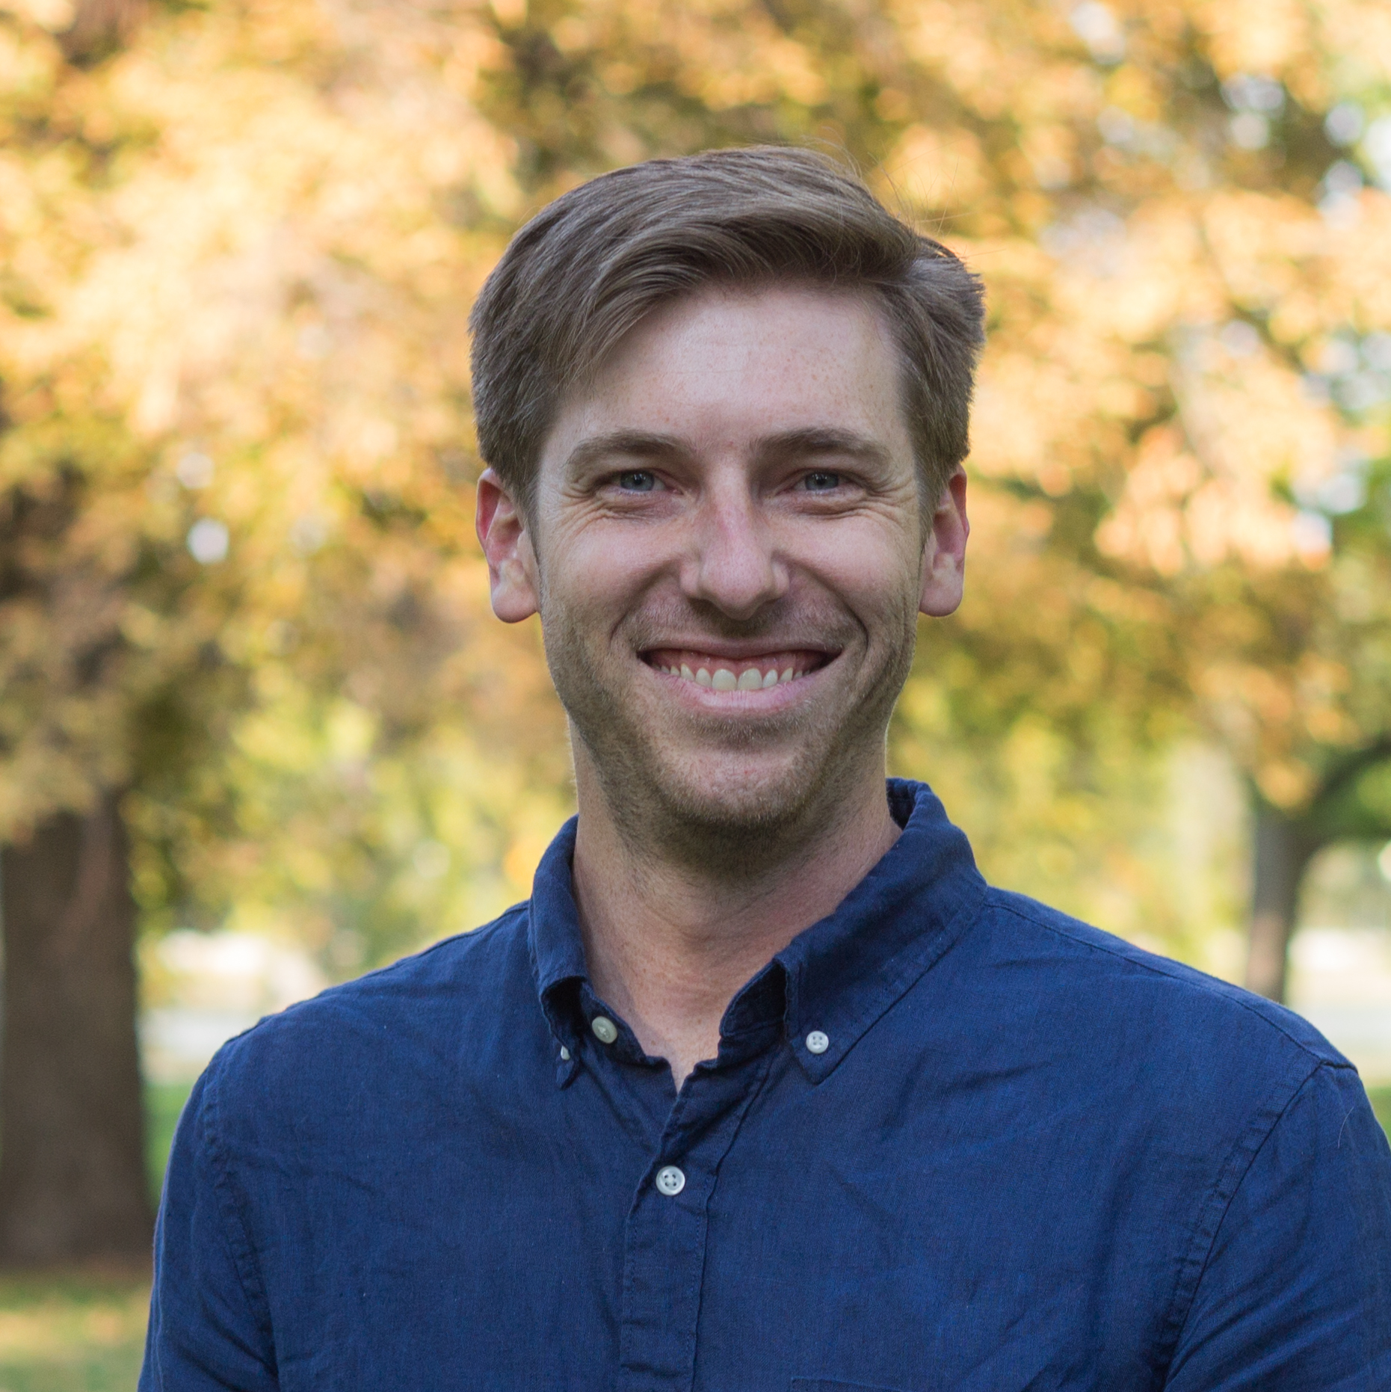
Garrison Neely Senior Director — Cloud & Product
Email
garrison.neely@thebridge.com
Location
Denver, CO
Mobile
(803) 270-2107
Garrison joined The Bridge in August 2024. With a two-decade career spanning industry and consulting roles, Garrison leads clients and development teams from ideation through implementation, delivering scalable, secure, and resilient software solutions.
EXPERIENCE
Industry Experience
Financial Services | Biopharma | Agriculture | Healthcare | Staffing | Hospitality | Fast Casual Restaurants
Consumer Genetic Testing Product | Global Biopharma
Oversaw development of a novel genetic testing product and led a program that spanned 8 time zones, 2 cultures/languages, 40 people, and 2 integration partners.
Completed an FDA 510-K filing and achieved regulatory authorization for direct-to-consumer test.
Solution included Azure-based ReactJS/.NET Core order and results portal, utilizing Azure B2C for authentication, and Terraform for infrastructure automation.
Product Personalization System | Luxury Hospitality
Architected and delivered the system complete with a fully-trained machine learning (ML) recommendations engine, hitting all milestones in the 9-month project plan.
Built rapport with an influential software architect on the development team.
Credit Card Payment Service | Fast Casual Pioneer
Enabled client to stop storing credit card detail and divest itself of brick-and-mortar datacenters by delivering a tokenized, Azure-based cloud payment service (utilizing Payeezy) that met all of the company’s monitoring and performance needs. API was performant to 350,000 transactions per minute, written in C#.NET.
BACKGROUND
Functional Skills
Software Architecture, Engineering Leadership,
Program Management, DevOps, Tech Strategy, Digital Transformation & Innovation, Cross-Functional Collaboration, Product Roadmapping
Qualifications
Technology leader focused on Cloud & Product engineering. Garrison leads large, continent-spanning teams delivering FDA-regulated products, guides clients on their cloud journeys, and advises decisionmakers on where to take products next.

Slide 2

Email
garrison.neely@thebridge.com
Location
Denver, CO
Mobile
(803) 270-2107
Garrison joined The Bridge in August 2024. With a two-decade career spanning industry and consulting roles, Garrison leads clients and development teams from ideation through implementation, delivering scalable, secure, and resilient software solutions.
Garrison Neely Senior Director
Cloud & Product

Slide 3
Garrison Neely Senior Director — Cloud & Product
Email
garrison.neely@thebridge.com
Mobile
(803) 270-2107
Location
Denver, CO
BACKGROUND
EXPERIENCE
Functional Skills
Software Architecture, Engineering Leadership,
Program Management, DevOps, Tech Strategy, Digital Transformation & Innovation, Cross-Functional Collaboration, Product Roadmapping
Qualifications
Technology leader focused on Cloud & Product engineering. Garrison leads large, continent-spanning teams delivering FDA-regulated products, guides clients on their cloud journeys, and advises decisionmakers on where to take products next.
Industry Experience
Financial Services | Biopharma | Agriculture | Healthcare | Staffing | Hospitality | Fast Casual Restaurants
Consumer Genetic Testing Product | Global Biopharma
Oversaw development of a novel genetic testing product and led a program that spanned 8 time zones, 2 cultures/languages, 40 people, and 2 integration partners.
Completed an FDA 510-K filing and achieved regulatory authorization for direct-to-consumer test.
Solution included Azure-based ReactJS/.NET Core order and results portal, utilizing Azure B2C for authentication, and Terraform for infrastructure automation.
Product Personalization System | Luxury Hospitality
Architected and delivered the system complete with a fully-trained machine learning (ML) recommendations engine, hitting all milestones in the 9-month project plan.
Built rapport with an influential software architect on the development team.
Credit Card Payment Service | Fast Casual Pioneer
Enabled client to stop storing credit card detail and divest itself of brick-and-mortar datacenters by delivering a tokenized, Azure-based cloud payment service (utilizing Payeezy) that met all of the company’s monitoring and performance needs. API was performant to 350,000 transactions per minute, written in C#.NET.

Slide 4










 | USE OVER DARK BACKGROUND | USE OVER LIGHT BACKGROUND
STRATEGY & ADVISORY
DATA & AI
EXPERIENCES
CLOUD & PRODUCT
ACCELERATION

